Slide 1
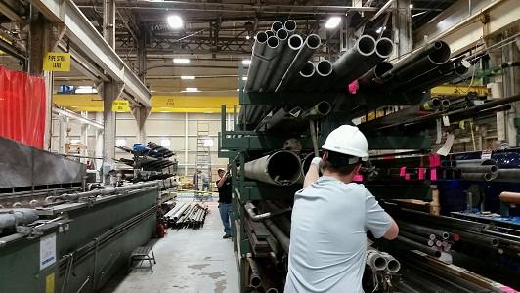

HS&E INCIDENT BULLETIN |  | 2nd half year 2014
U.S. | Type of incident - Slip/Trip/Fall from same level
Summary:
An employee was working with a second employee while attempting to remove a piece of angle iron from a storage rack. The employee was attempting to pull the angle iron out using a 1-inch nylon lifting strap when the strap slipped, causing the employee to lose balance. The resulting twisting motion, coupled with his left foot “sticking” to floor due to good traction, resulted in 2 fractures above the left ankle.
Root Causes: | Actions Taken Thus Far: Next Steps
Use of incorrect tool, shortcut taken instead of using crane | Stand down on using the tools available and not taking safety shortcuts, perform 6S on rack

